Slide 1

Real-Time Chat Application
GUIDED BY:
Dr.S.irin Sherly,M.E,Ph.D..,
professor-Department of CSE SIMATAS Engineering,
TEAM MEMBERS:
M.Dinesh(192211763)
R. Bhargav(192210452)
SK.Shabbir Ali(192211460)

Slide 2

Abstract
This project explores the development of a real-time chat application using modern technologies. The application aims to provide a user-friendly and efficient platform for instant communication and collaborative activities.

Slide 3
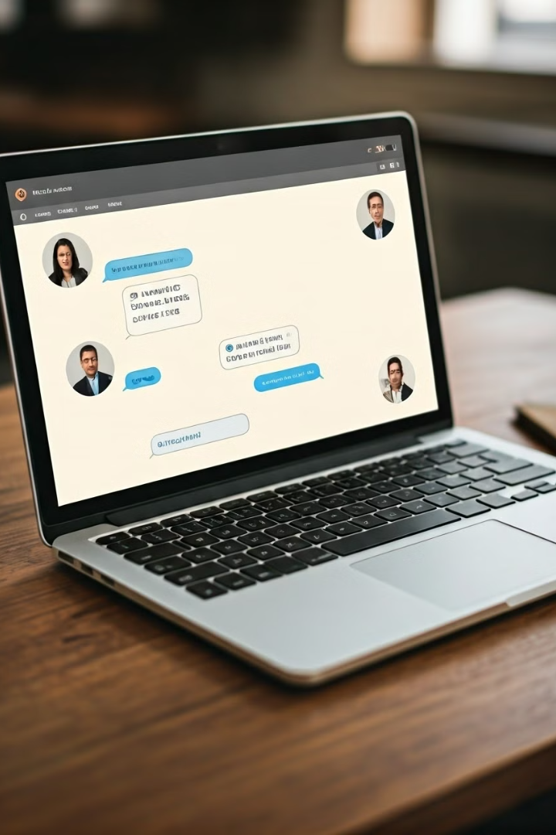
Introduction
The demand for real-time communication has increased significantly with the rise of social media and collaborative applications. This project aims to address this demand by creating a robust and user-friendly real-time chat application.

Slide 4
Real-Time Communication Protocols
WebSockets
MQTT (Message Queuing Telemetry Transport)
XMPP (Extensible Messaging and Presence Protocol)
WebSockets enable persistent, bi-directional communication between a client and server, facilitating real-time updates and data exchange.
MQTT is a lightweight messaging protocol ideal for resource-constrained devices and applications that require real-time data exchange.
XMPP is a protocol designed for instant messaging and presence information, allowing users to know the status of their contacts.

Slide 5
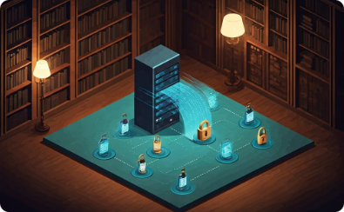



System Requirements
Real-Time Messaging
Scalability
Security
User Interface
The application must support real-time messaging with minimal latency, enabling a seamless and responsive communication experience for users.
Scalability is a key requirement, ensuring the application can handle a large number of concurrent users without compromising performance.
Security is paramount, protecting user data and ensuring secure communication channels. Encryption and secure protocols will be implemented to safeguard data transmission and user authentication.
The application's user interface must be user-friendly, intuitive, and easy to navigate.

Slide 6
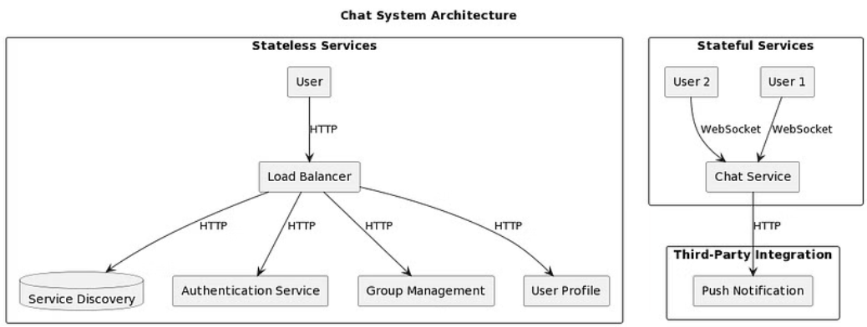
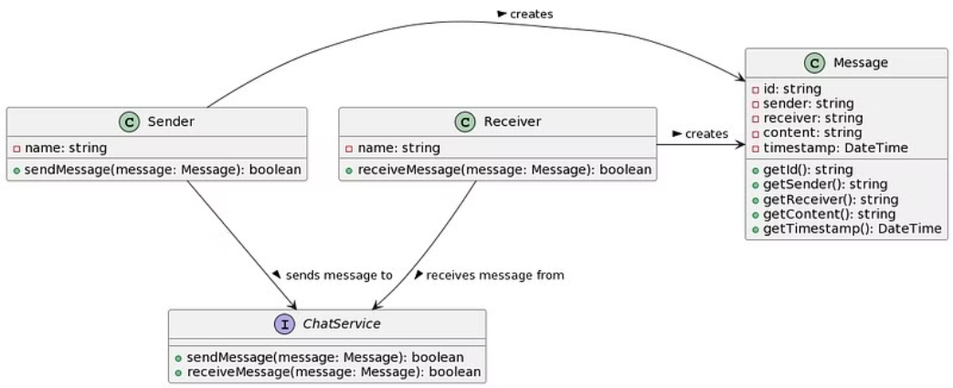
ARCHITECTURE

Slide 7
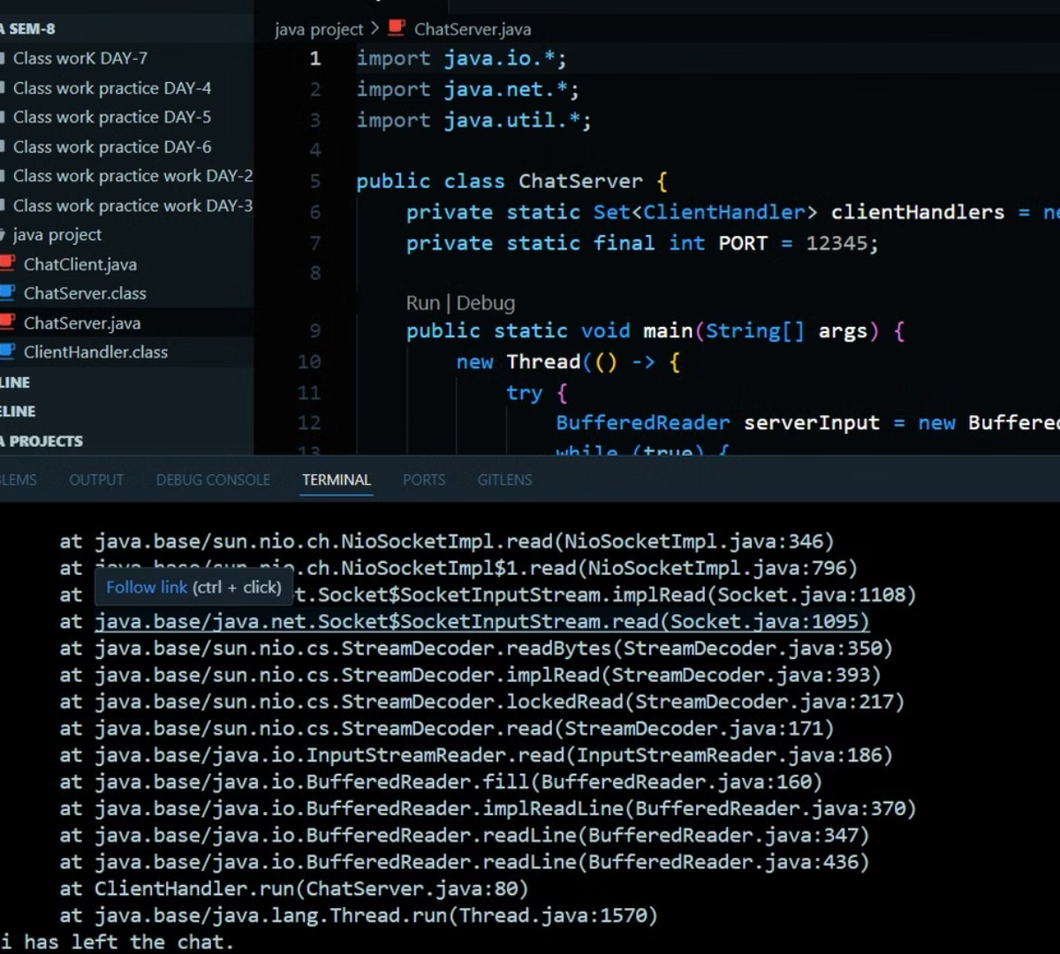
Output
The output of this project will be a fully functional real-time chat application, with a robust backend infrastructure and a user-friendly interface. The application will be thoroughly tested and deployed for public use.

Slide 8



Conclusion
Collaboration
Innovation
Future Development
The development of this real-time chat application represents a collaborative effort, bringing together diverse skills and expertise.
The application leverages advanced technologies and innovative approaches to deliver a seamless and reliable communication experience.
Future development will focus on enhancing features, expanding functionalities, and addressing evolving user needs.

